Slide 1
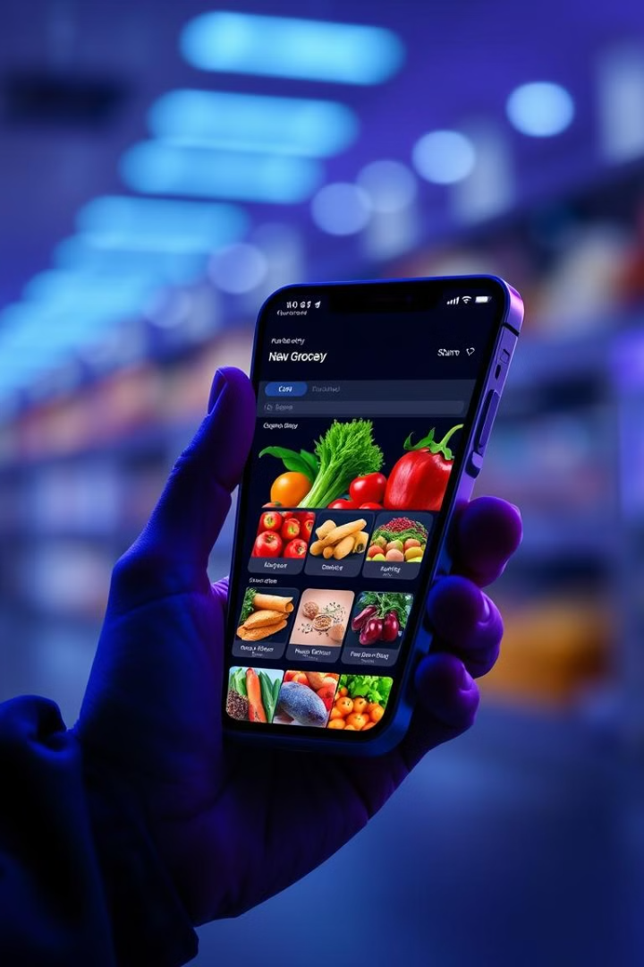
Smart Grocery: Revolutionizing Online Grocery Shopping
Smart Grocery is an innovative AI-driven platform transforming the online grocery shopping experience. It offers personalized recommendations, real-time updates, and seamless checkout processes, making grocery shopping more efficient and convenient for users.

Slide 2
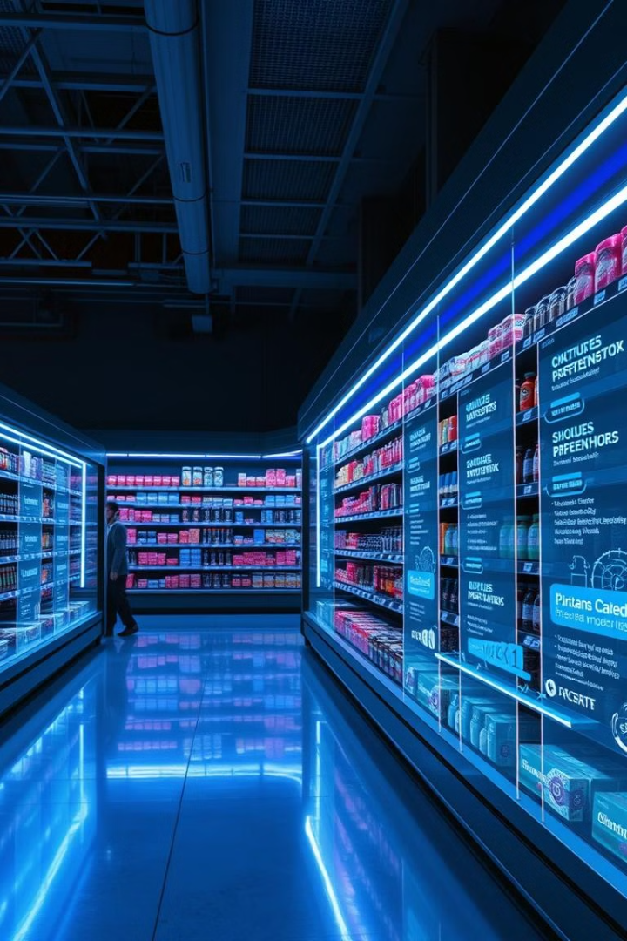

Project Overview and Objectives
1
Project Overview
Smart Grocery is an innovative online grocery platform designed to modernize the grocery shopping experience. It provides users with a personalized, efficient, and seamless experience through AI-driven recommendations and real-time updates.
2
Objective
To make grocery shopping faster and more convenient by offering personalized recommendations, streamlined shopping, and an efficient checkout process.

Slide 3




User Types and Roles
Consumers
End-users who browse products, make purchases, and interact with the platform's features.
District Operations Managers
Oversee regional inventory, ensuring product availability and managing local logistics.
Administrators
Manage overall platform operations, user accounts, and monitor system performance.

Slide 4
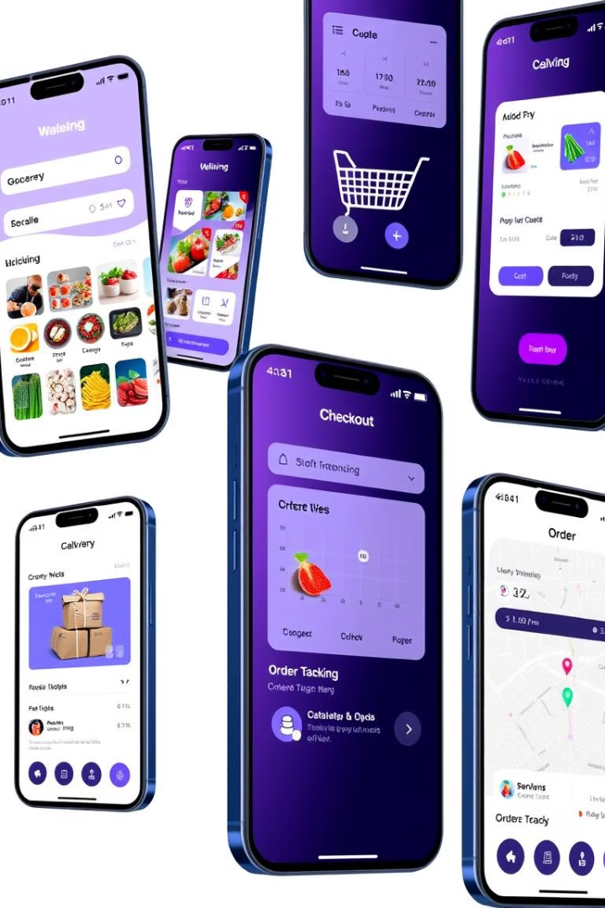
Key Functionalities
1
User Authentication
2
Smart Shopping Cart
Implements secure login and registration processes. Utilizes encryption and token-based authentication for enhanced security.
Provides real-time updates on product availability and pricing. Allows easy modification of cart contents with instant total recalculation.
3
Diverse Payment Options
4
Review System
Supports multiple payment gateways including credit cards, UPI, and digital wallets. Ensures secure transactions through encryption and tokenization.
Enables users to rate products and leave detailed reviews. Implements sentiment analysis to highlight key product features and user opinions.
5
Wishlist
6
Product Catalog:
Allows users to save favorite items for future purchases.
Comprehensive listings with detailed product descriptions, images, and filters for a smooth browsing experience.
7
Download Invoice:
8
Checkout:
Users can download detailed invoices for their purchases.
Multiple secure payment options for a smooth and safe purchasing process.

Slide 5





Technology Stack
Front-end: React.js
Builds a dynamic and responsive user interface for seamless user interactions.
Back-end: Node.js & Express.js
Manages server-side operations, API endpoints, and business logic processing.
Database: MongoDB
Stores and manages user data, product information, and transaction records efficiently.
Other Technologies:
JS(JavaScript) : A scripting language used to create dynamic, interactive web pages on both the client and server sides.
JSON: A lightweight format for data exchange between server and client, easy to read and write.
CSS : A styling language that defines the look and layout of web pages.
CLOUDINARY : A cloud-based media management tool for storing, optimizing, and delivering images and videos efficiently.
FIREBASE : Used for Google Authentication.

Slide 6
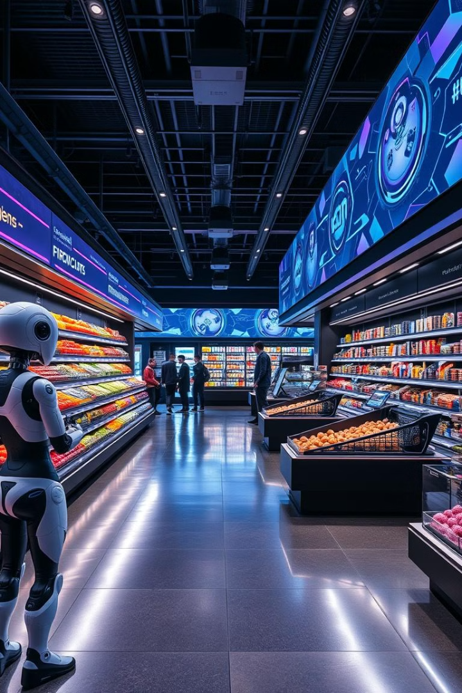
Future Enhancements
1
AI-Driven Personalization
Implement machine learning algorithms for tailored product recommendations and dynamic pricing.
2
Integrated Meal Planning
Offer recipe suggestions with automatic ingredient addition to the shopping cart.
3
Advanced Logistics
Develop real-time delivery tracking and efficient supplier management systems.
4
AI-Generated Content
Utilize natural language processing for automated, personalized product descriptions.
5
Supplier Management:
Tools for suppliers to manage inventory, stock updates, and order fulfillment, ensuring efficient operations.
6
Dynamic Pricing and Deals:
Real-time pricing adjustments based on stock levels, location, and demand to ensure competitive pricing.
7
Voice Assistance:
Integration of voice-activated assistance to help users navigate the platform, add items to the cart, and receive product recommendations hands-free, enhancing accessibility and user convenience.

